Slide 1
A1: Visualization Curation and Analysis
CSE412: Data Visualization
Shuyi Yeh, shuyiyeh@uw.edu, AC
Assignment Link

Slide 2
Part 1: Data Collection & Curation
Screenshots, photos, and/or videos of visualizations that you encounter in your life with a brief description of each and organized in a principled fashion.
You need at least 10 visualizations for Part 1

Slide 3
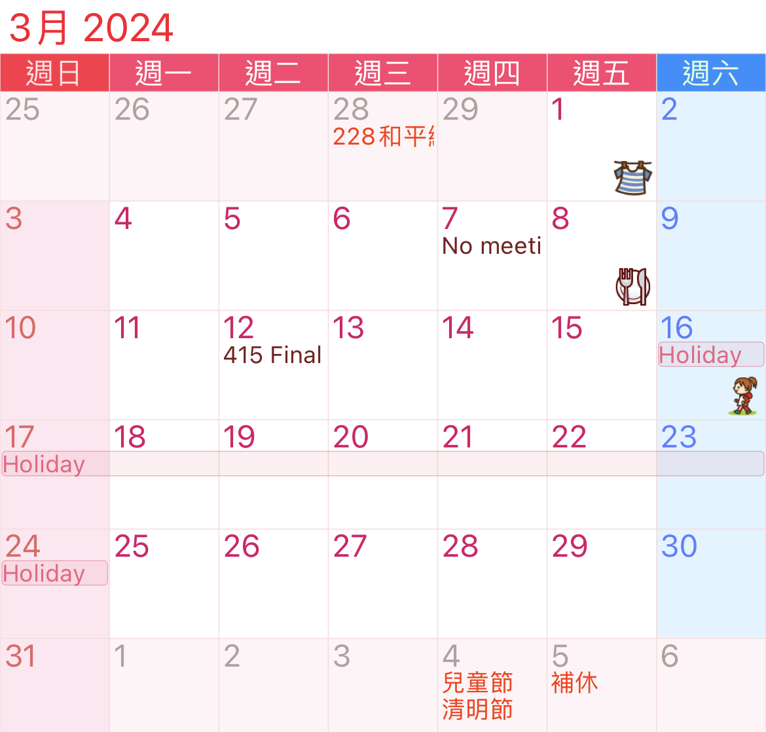
Calendar Visualization
1. Jorte APP
Notes:
Enter brief description of the visualization and how it relates to your life

Slide 4
Calendar Visualization
1. Jorte APP
Brief description
It is a chinese calendar app in the phone. It not only records important meeting and class but also presents the image to visualize some activities. What’s more, it will automatically shows every chinese holiday with red words.
How does it relate to your life?
I use this calendar app every day. This can help me to remember everything and their time. There are lots of calendar app, but I like this one the most because it shows small cute image which can help me understand what should I do instantly without reading the text.

Slide 5
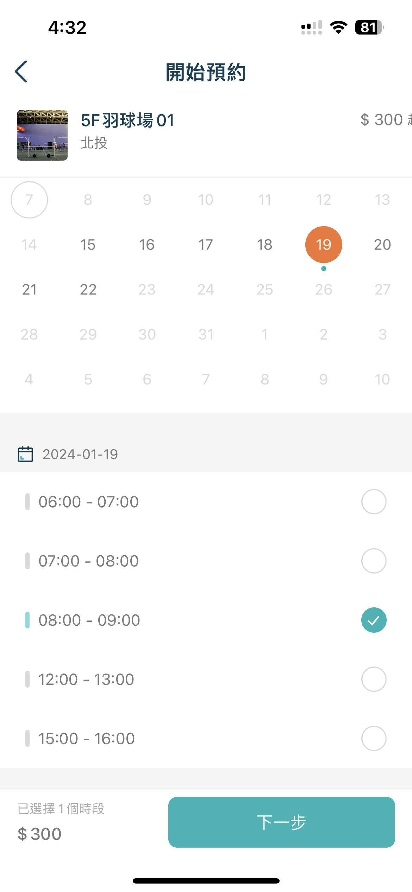
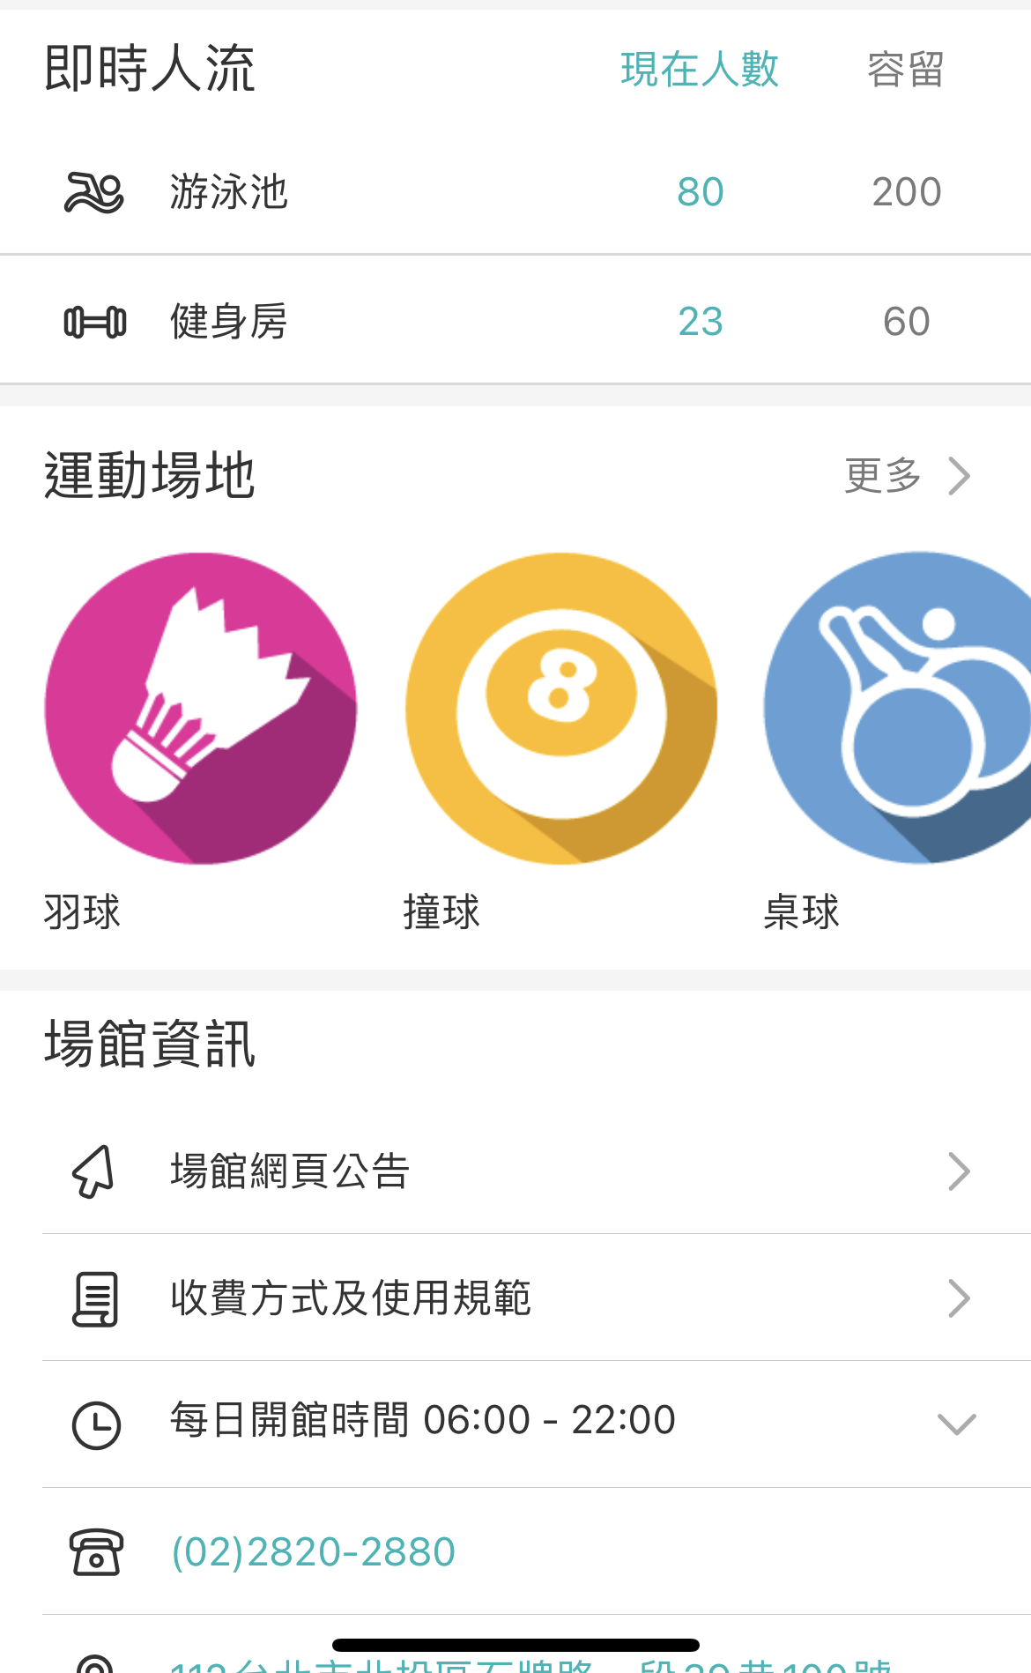
Calendar Visualization
Start Reservation
2. Smart Sports Center APP
Type of Sport
Notes:
Enter brief description of the visualization and how it relates to your life

Slide 6
Calendar Visualization
Start Reservation
2. Smart Sports Center APP
Brief description
This visualization shows a sport center app in Taiwan. It integrates all sport center in the city. We can use this app to see the type of sport field in every sport center. Also, we can use the built-in calendar to search for all available time and schedule the specific time slot of a field.
How does it relate to your life?
I really like this integrated system and used it every week last year. With it, I can easily check for all the center to find the badminton field without calling every sport center separately. Its visualization is clear understandable for all age.
Type of Sport

Slide 7
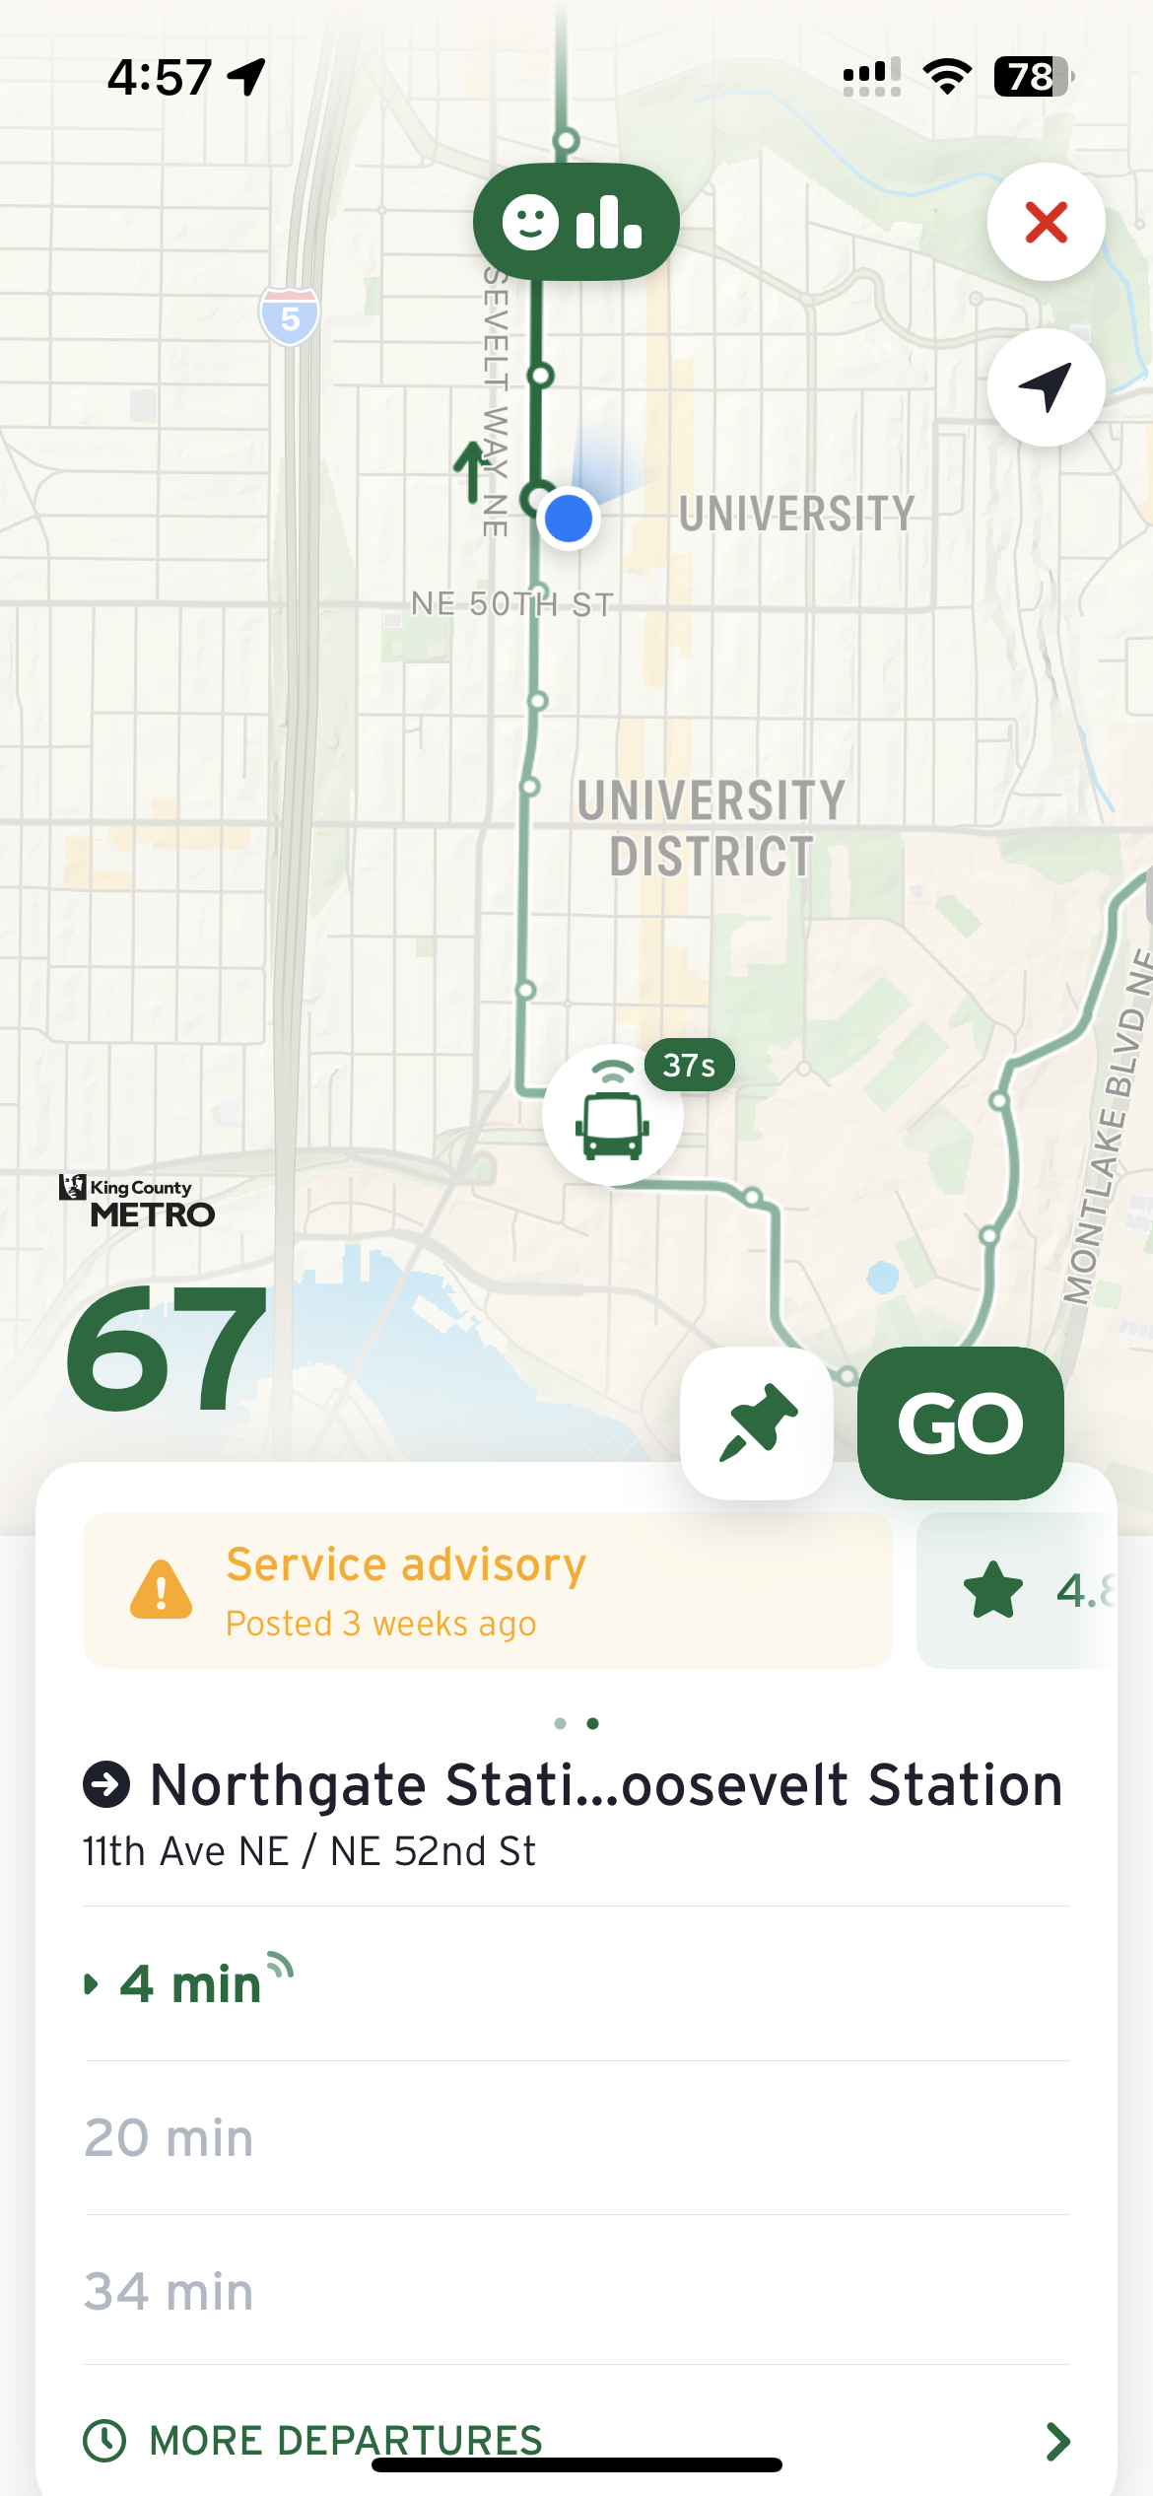
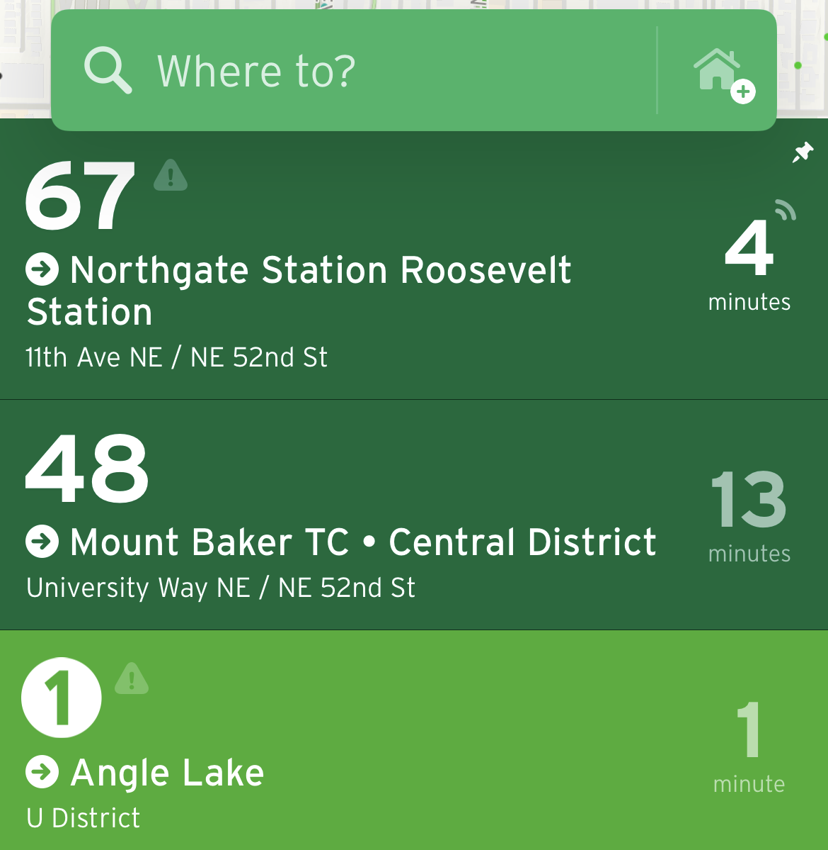
Map Visualization
3. Transit APP
Notes:
Enter brief description of the visualization and how it relates to your life

Slide 8
Map Visualization
3. Transit APP
Brief description
This visualization is extracted from Transit APP. This is an APP for seattle bus information. It can detect the surrounding bus stop and calculate expected time of every bus. Also, we can see the route of the bus and see the location of the next bus.
How does it relate to your life?
When heading to UW, I use this app to check the bus schedule in advance. The visualization of bus route map is very clear for me. It also provides real-time information on how long I'll need to wait for the bus. Therefore, I can efficiently plan my time and avoid unnecessary waiting.

Slide 9
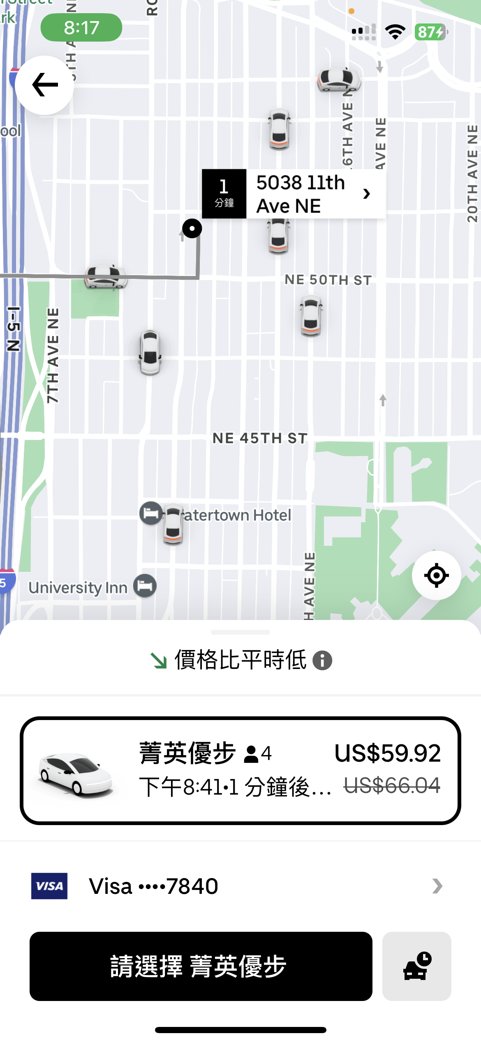
Map Visualization
4. Uber APP
Notes:
Enter brief description of the visualization and how it relates to your life

Slide 10
Map Visualization
4. Uber APP
Brief description
This is a visualization for Uber App. Uber is a platform for booking a ride. After entering destination, it will automatically show all surrounding cars and choose the nearest one. It can also shows the price, number of seats, and the waiting time.
How does it relate to your life?
I like to use Uber APP to book a ride rather than find a taxi on the street recently because Uber APP has a really clear interface. It has shown all the information I need online. And I can know the exact fare before departure, so I don’t have to worry about the traffic jam which might make the price become higher.

Slide 11
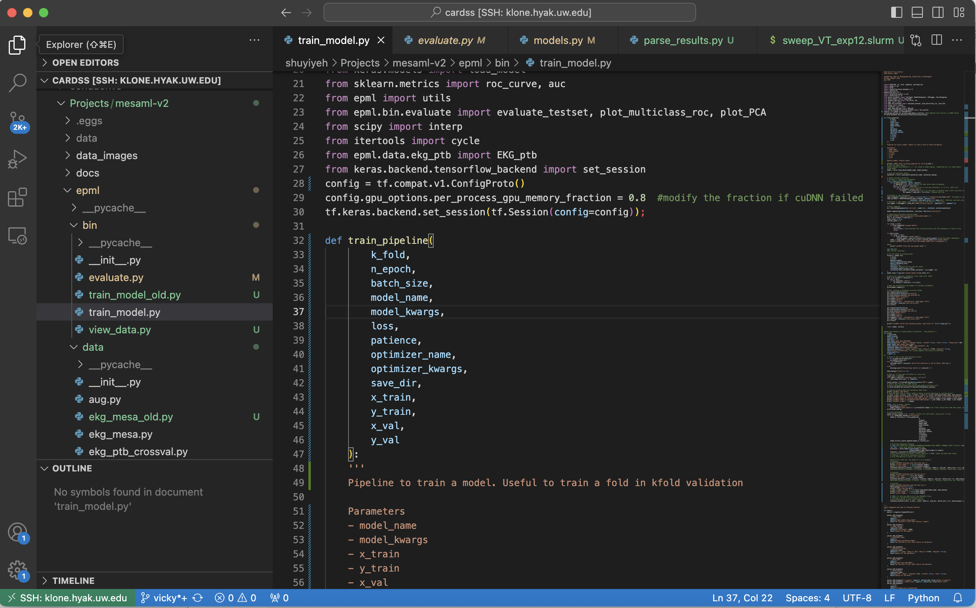
Work Visualization
5. Visual Studio Code
Notes:
Enter brief description of the visualization and how it relates to your life

Slide 12
Work Visualization
5. Visual Studio Code
Brief description
This visualization is a streamlined code editor, Visual Studio Code. It support multiple programming languages. It utilizes syntax highlighting, displaying code in different colors based on its type. For example, words with orange color mean comment and words with bule color mean attribute. This syntax highlighting can help people understand the code much faster.
How does it relate to your life?
I use Visual Studio Code really often in the lab and course. Its clear visualization can help me familiar with a new programming language more easily.

Slide 13
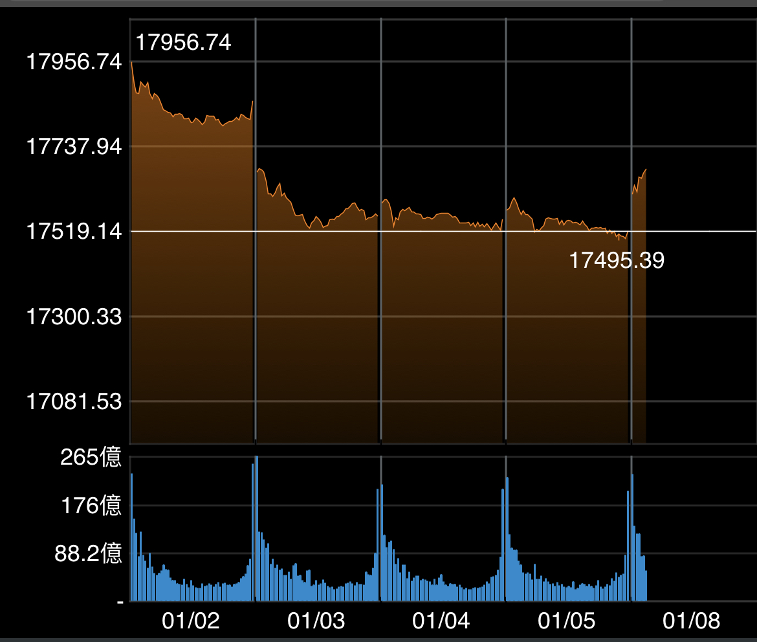
Work Visualization
6. Stock Price Index
Notes:
Enter brief description of the visualization and how it relates to your life

Slide 14
Work Visualization
6. Stock Price Index
Brief description
This is visualization for stock price index for the current week. We can understand the trend of the index by observing the line chart. Additionally, the bar chart illustrates the daily trading volume, providing further insight into market activity.
How does it relate to your life?
Since I also hold a few stocks, by observing the trend in stock prices and trading volume, I can predict the optimal moments for buying and selling. What’s more, it can also help me learn risk management.

Slide 15
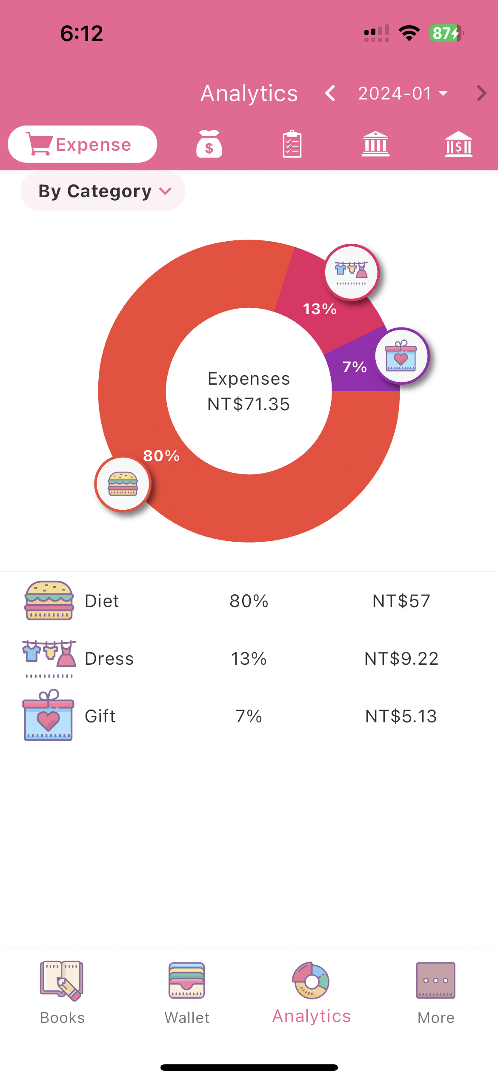
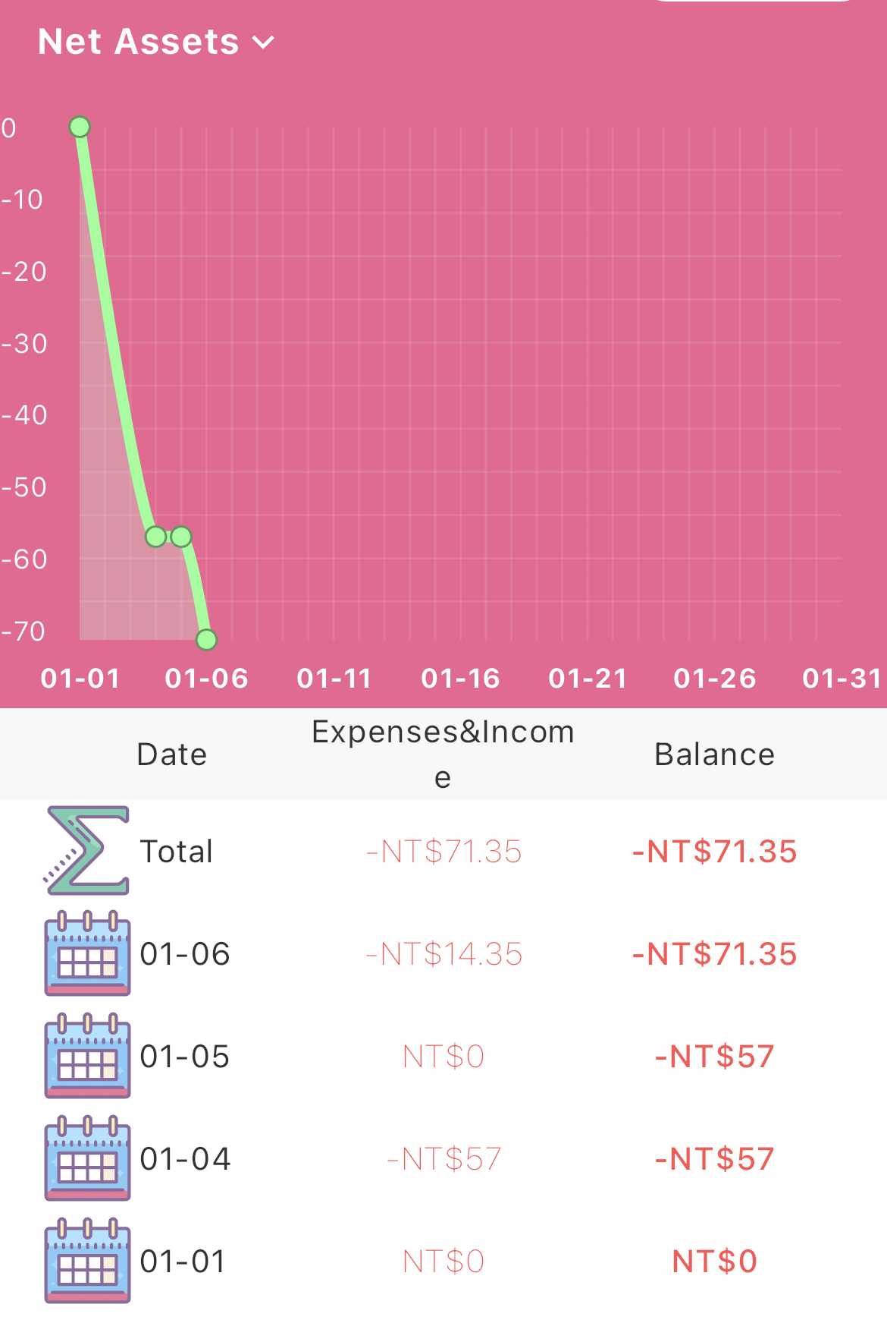
Record Visualization
7. Money+ APP
Notes:
Enter brief description of the visualization and how it relates to your life

Slide 16
Record Visualization
7. Money+ APP
Brief description
These visualizations are generated by an app designed for tracking daily expenses. Upon recording expenses, the app creates a pie chart to show the percentage of expense from different category. In addition, it will also provide a line chart to show the the daily spending trends.
How does it relate to your life?
This is a new APP I just started to utilize to track my expense. The advantage of this app is its style. The visualization is very cute and understandable. While other app just record the income and expense with number, it presents them in a more readable way.

Slide 17
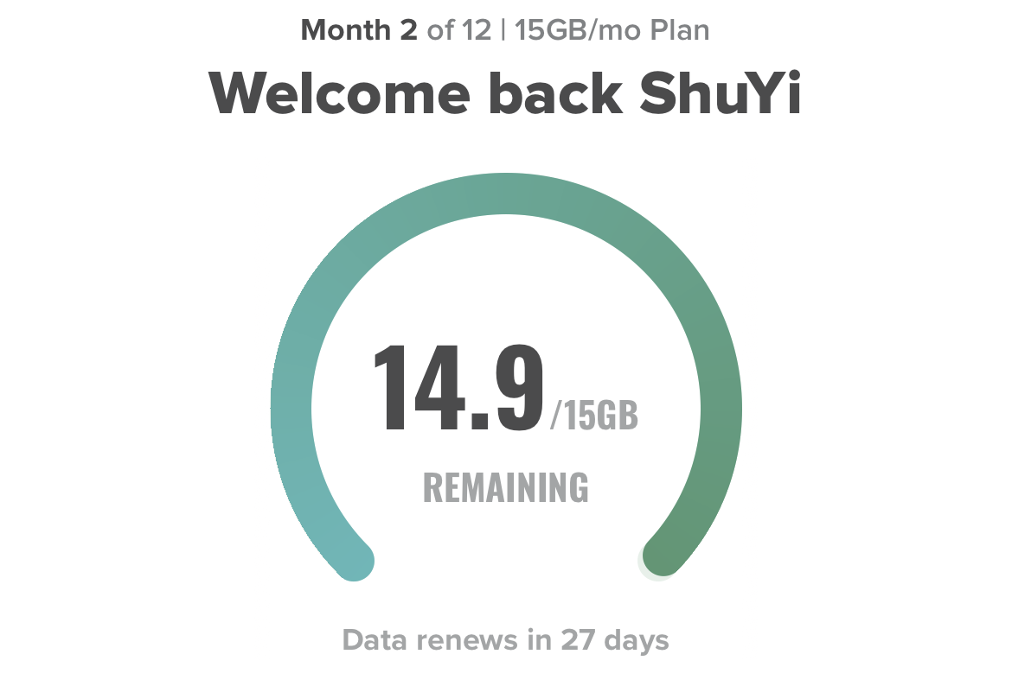
Record Visualization
8. Mint Mobile APP
Notes:
Enter brief description of the visualization and how it relates to your life

Slide 18
Record Visualization
8. Mint Mobile APP
Brief description
This visualization is a screenshot from Mint Mobile App. Mint Mobile is a company which provides lots of wireless plan for internet. Its APP on the phone shows remaining data every month.
How does it relate to your life?
By downloading this APP, I can monitor how many data left in this month. As a result, I can manage my internet usage effectively, avoiding the situation of running out of data in advance. I can also prevent potential emergencis.

Slide 19
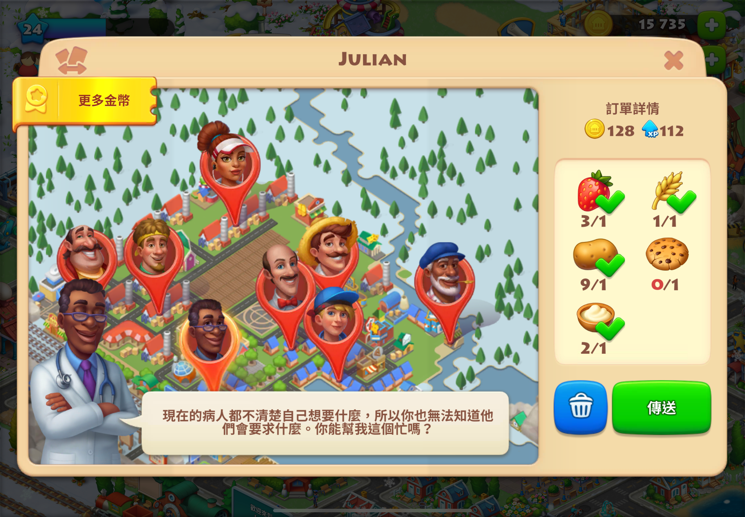
Game Visualization
9. Dream Town
Notes:
Enter brief description of the visualization and how it relates to your life

Slide 20
Game Visualization
9. Dream Town
Brief description
Dream Town is a game which ask player to build a small town by themselves. Player has to build factories and farm, creating various kind of food to meet villager’s need. After earning money, the town will grow and expand. This visualization shows all villager position and their orders. We can see the list at the right side to invent what they want.
How does it relate to your life?
I play this farming game when I’m free. Playing this game gives me a sense of achievement because I can expand and enrich my virtual world when making effort on it.

Slide 21
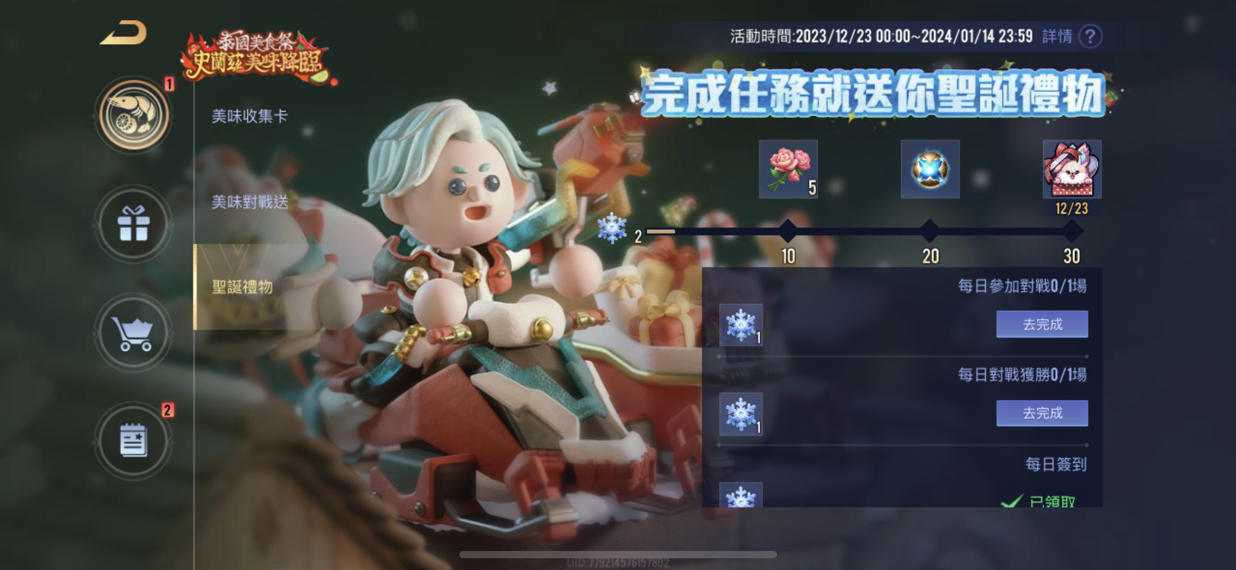
Game Visualization
10. Arena of Valor
Notes:
Enter brief description of the visualization and how it relates to your life

Slide 22
Game Visualization
10. Arena of Valor
Brief description
This visualization is from a game named Arena of Valor. It is a multiplayer online battle game on the cellphone. The image depicts a collection bar that can be filled by completing various tasks. Once the bar is filled, a big reward can be obtained.
How does it relate to your life?
I used to play Arena of Valor before. It is an exciting activity with friends. The collection bar adds an extra motivation as completing tasks because it not only contributes to the progress of the game but also leads to valuable rewards.

Slide 23
Part 2: Visualization Critique
Select three visualization from your curated set to analyze and critique them.

Slide 24
Selected Visualizations For Critique
I selected these three visualizations because they are all practical APPs on my phone. They represents different categories: Calendar visualization, Map visualization, and Record visualization, respectively. Their visualization effect are very attractive and understandable.
Smart Sports Center App
Transit App
Money+ App

Slide 25
Calendar Visualization
2. Smart Sports Center APP
Maximum visitors
Real-time number of visitors
Available reservation time: We can reserve for the field in the following week
Time slot: After choosing a day, it shows remaining time slot for reservation
Type of Sports: We can see available type of sport field in a sport center
Open hours and phone number: necessary information
Price
Notes:
Enter brief description of the visualization and how it relates to your life

Slide 26
Calendar Visualization
2. Smart Sports Center APP CRITIQUE
What is the goal of this visualization?
This visualization is intended to provide a way of reservation for people who want to book a sport field. By using this integrated APP, they can search for available field and time slot more easily.
How is the data represented—its visual encoding, graphical marks, color, etc.?
It shows data in a calendar form. Dates with black color mean they are available now, while dates with gray color mean they cannot be booked. The time slot below are all selectable, when selecting, it will shows a green checkmark and its price below.
What are some key strengths of this visualization and why?
Its format of calendar can let people schedule their time more efficiently.
The date, time slot, and price are both shown in the same page. It is very readable.
What are some key weaknesses of this visualization and why?
The time with black sometimes shows no time slot below. If there is no field left in a day, marking it with gray color will be better.
We need to click every day to check the suitable time slot. It will be better to create a function to filter the specific time slot in the whole week.

Slide 27
Map Visualization
3. Transit APP
My location
Bus list: The bus we can take in surrounding bus stop
Bus route
The location of the closest bus
Three closest bus and the remaining waiting time
Bus number
Notes:
Enter brief description of the visualization and how it relates to your life

Slide 28
Map Visualization
3. Transit APP
What is the goal of this visualization?
This visualization is intended to provide people information of real-time bus location and waiting time in Seattle. By using Transit, we can know following bus and find the fastest way to arrive the destination.
How is the data represented—its visual encoding, graphical marks, color, etc.?
It shows data in a mat format. It shows a bus route in the map and especially highlight the direction with dark green. There is a bus mark which gives us precise location of the bus, rather than just showing the time only.
What are some key strengths of this visualization and why?
The arrow to show the direction can prevent people from taking the opposite direction bus.
It also shows user location in the same map, which make us realize the relative position more easily.
What are some key weaknesses of this visualization and why?
The color of the whole page are mostly green. Although it’s more beautiful, it might not be readable for elderly.
The time close to bus mark might mislead users. It means the time after the last update. But users might not know its meaning without explaining.

Slide 29
Record Visualization
7. Money+ APP
Pie chart: It shows the percentage of expenses from different categories
Line chart: It shows the trend of expenses in a month
Detailed list
Expense list: expenses every day and the total value
Notes:
Enter brief description of the visualization and how it relates to your life

Slide 30
Record Visualization
7. Money+ APP
What is the goal of this visualization?
The goal of these visualizations are to help people record daily expense with a more explicit chart. It can help people see the trend of spending money and realize which category they spend the most.
How is the data represented—its visual encoding, graphical marks, color, etc.?
It shows data in two format: pie chart and line chart. It not only display the percentage on the pie chart but also use small schema to represent different categories. As for the line chart, it use green line to indicate the change of expense.
What are some key strengths of this visualization and why?
The color of two figures are both bright and have contrast against background.
Small schema strengthen the characteristic of this APP, making it cuter and more attractive.
What are some key weaknesses of this visualization and why?
The line chart shows the trend of this month only, but I think it will be more effective to show recent 30 days rather than start with the first day of the month.
Users can only record the expense with categories. If the expense records are based on shop names rather than categories, the pie chart would become very chaotic.

Slide 31
Learning reflection
In this assignment, I've observed that visualization is present everywhere. In my daily life, I encounter visualization in almost every APP, ranging from gaming to professional tools. This is what I didn’t notice before. After analyzing them, I realize that good visualization plays an vital role in users’ choice when selecting apps or devices. For example, when there are numerous calendars options with similar function, users tend to consider factors like color and style, choosing the most understandable one.
Furthermore, I learn to critique the strength and weakness of every visualization. I realize that color contrast in a chart is really important. And I also learn various methods to integrate concise texts and graphics, making it easier to convey detailed information to users. Although visualization is still a profound field, I think I have gain more insight into it now.

